Slide 1




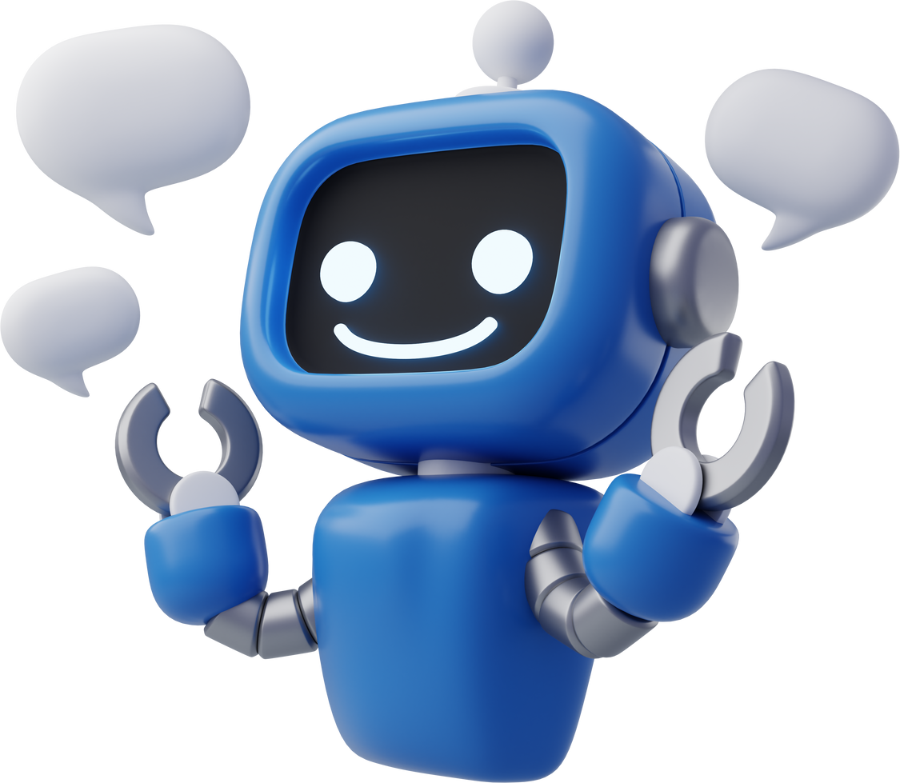



Laguna State Polytechnic University
Presentation of
Libby the Library Assistant
A library assistant chatbot

Slide 2
Laguna State Polytechnic University
Presentation of
Libby the Library Assistant
A library assistant chatbot

Slide 3
1
Introduction

Slide 4

Introduction
Libby is a simple library assisting chatbot that helps users find book titles and easily check the book’s information and availability. Libby can also recommend similar books using keywords given by the user.
Our chatbot was developed using Google Colab and various library and modules, such as pandas, sklearn, spacy, gradio, and etc. With these libraries, Libby was able to integrated.
During this presentation, we’ll show and tackle how Libby works and how the users can use the chatbot.

Slide 5
2
How Libby Works

Slide 6
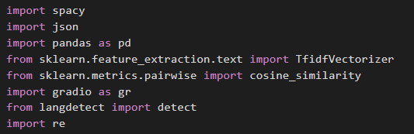
How Libby Works
Libby uses multiple libraries and modules to function. Here are the libraries used:
Natural Language Processing:
SpaCy: Extracts keywords from user input.
Langdetect: Detects the language of the input text.
Machine Learning:
TF-IDF Vectorizer: Identifies text similarity.
Cosine Similarity: Matches user input to dataset entries.
Data Handling:
Pandas: Manages book and response datasets.
User Interface:
Gradio: Creates an interactive chatbot UI.

Slide 7
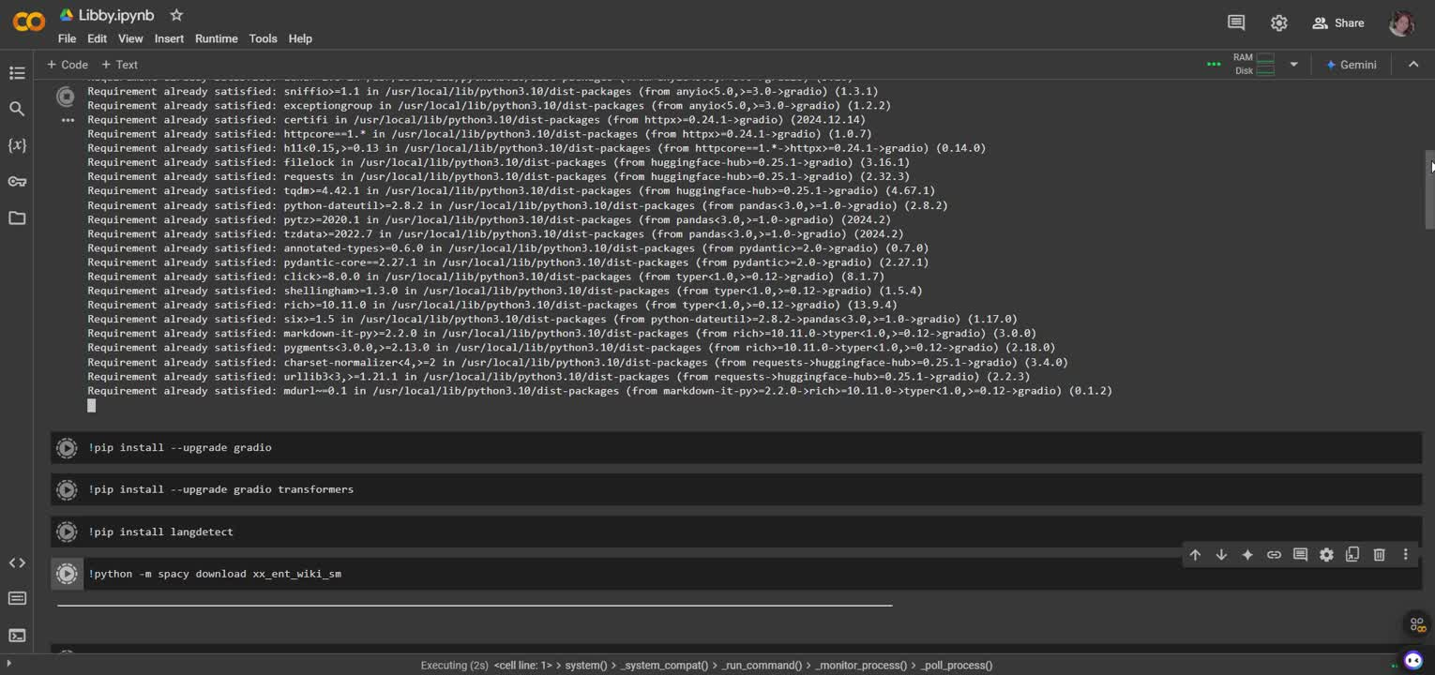
Steps to use Libby
Step 1: Run the file‘s cells to integrate Libby.

Slide 8
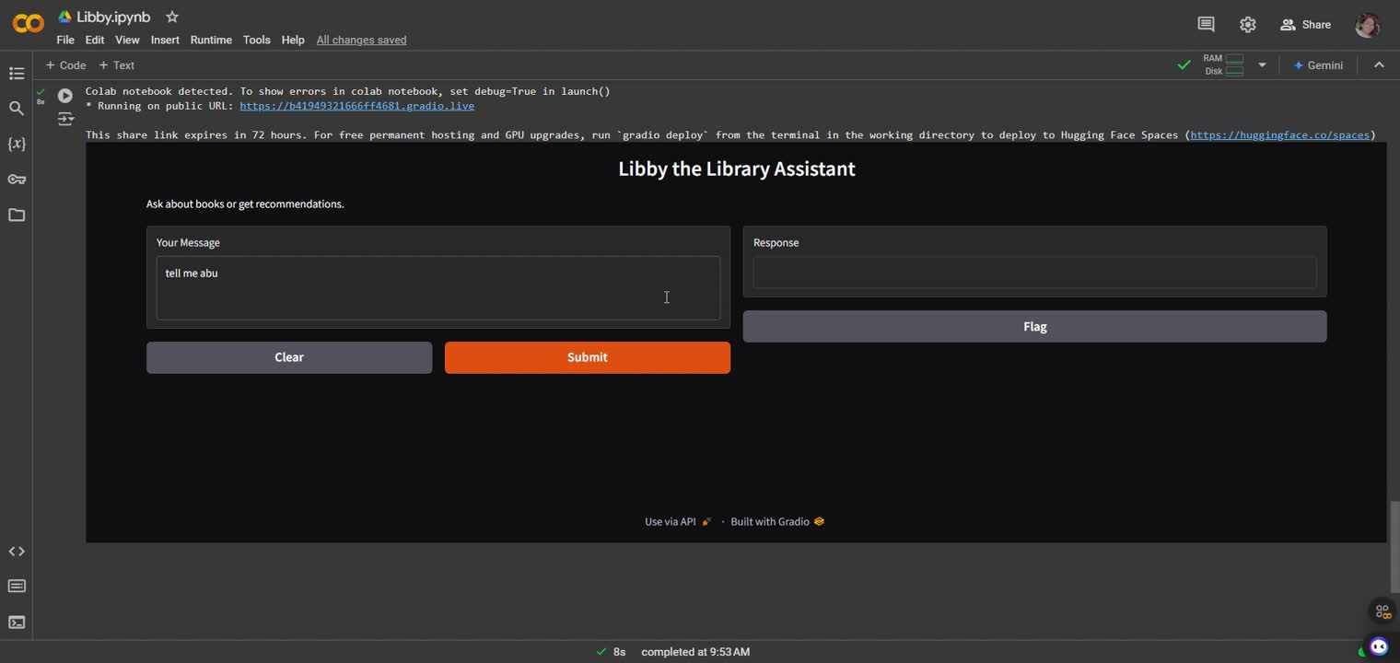
Steps to use Libby
Step 2: Type your query in the “Your Message” textbox.

Slide 9

Steps to use Libby
Step 2.1: If you want recommendation, start your query with “recommend”
*Still on prototype*

Slide 10
3
Challenges and Future Improvements

Slide 11

Challenges and Future Improvements
Enhance the personalization of responses through better user profiling.
Integrate real-time data analysis for more dynamic and relevant interactions.
Explore cross-platform compatibility to ensure seamless user experience across different devices.
Develop a more intuitive user interface to facilitate easier navigation and interaction.
Implement robust privacy measures to protect user data and build trust.
Expand language support to cater to a more diverse global audience.
Utilize machine learning to predict user preferences and tailor content recommendations accordingly.

Slide 12
4
Conclusion

Slide 13
Conclusion
Through these innovations, libraries are able to offer more personalized and efficient services. By integrating natural language processing, Libby can better understand and respond to the diverse needs of users, making information more accessible and interactions with library resources more seamless. Meanwhile, Gradio's platform ensures that even those who may not be tech-savvy can easily navigate and make the most of these digital tools, fostering an inclusive environment that encourages learning and exploration for all. Together, these technologies are transforming the way libraries connect with and support their communities, paving the way for a more interactive and dynamic future in public learning spaces.

